Slide 1
Indoor Locationing
Mehrdad Dehdashti,
Guy Lifshitz,
Shams Methnani,
Lauren Campbell,
Andrey Paunov

Slide 2
Why the interest?
Accuracy of positioning techniques
Ranging methods
Security and privacy
Device availability
WSN deployment restriction
Network scale
Implementation cost
Etc.

Slide 3
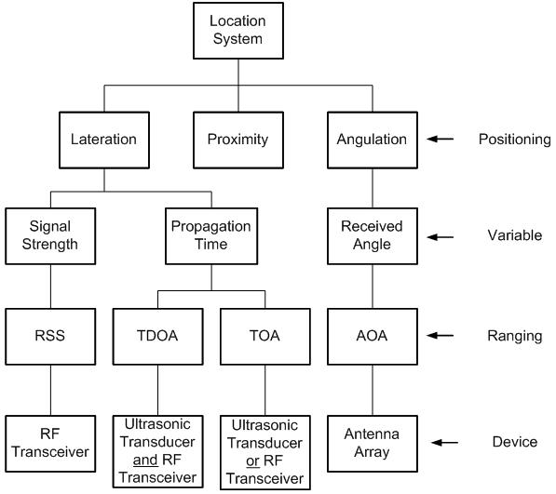
Classification of location tracking systems

Slide 4
Positioning aspect:
Proximity – Course grained (Rough estimation) of the target position
Angulation & Lateration – both use fine grained (precise estimations)
Variable aspect:
Received angle – between target and reference locations (angulation estimation)
Propagation time – signal transmission form transmitter to receiver (constant – used to find the distance between the target and the sensors)
Signal strength – measured at the receiver (signal strength inversely proportional to distance)

Slide 5
Ranging aspect:
Angle of arrival (AOA), time of arrival (TOA), time difference of arrival (TDOA), improvement over TOA, and received signal strength (RSS)
Device aspect:
Antenna array – measure angle of received signal, by comparing the phase difference of signal from different antennas
Radio frequency (RF) transceiver – measure the received power and provide to RSS

Slide 6
Algorithms
Hop – count Spreading
Triangulation Estimation
Trilateration Estimation

Slide 7
Indoor != Outdoor Locationing
 | Outdoor | Indoor
Path loss model | Linear | Affected by multi-path and shadowing
Accuracy | Easy to achieve but not necessary (wide space) | Difficult to achieve but important (small space)
Space | Wide and not limited | Small and mostly rectangular
Deployment | Random | Can be planned
Transmission power | Maximum to maintain Location/Quantity Indicator (LQI) | Adjusted to avoid interference
Height of reference nodes | Ground | Ceiling
Map | Global | Local
Table 1: Comparison of Indoor and Outdoor Location Tracking (Pu, 2009)

Slide 8
Advantages of using WSN for indoor locationing
Low power consumption
Inexpensive devices
Software configurable and flexible
Wide radio coverage
Good processing ability
Sufficient I/O for sensing and actuating
WSN abundant set of resources

Slide 9
Disadvantages of using WSN for indoor locationing
Sensor size constraint
Limited in processing capability
Storage capacity
Communication bandwidth
Battery power supply

